Slide 1
Ecology

Slide 2
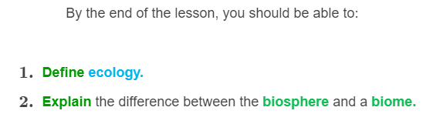


Slide 3

So, what exactly is ecology?
Ecology is the study of the relationships between living things and their physical environments.
The physical environment includes things like climate, water, and soil.

Slide 4
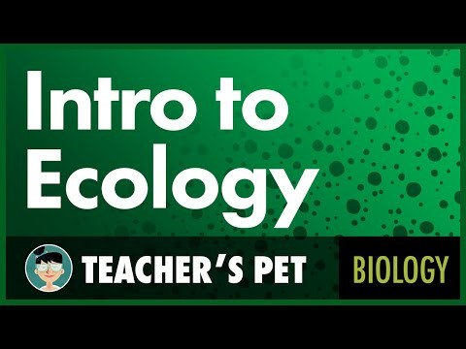

Slide 5
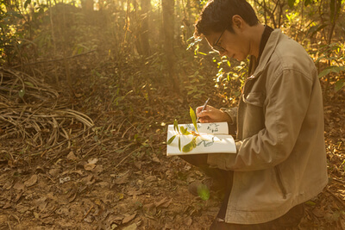
Ecologists are the scientists who study ecology.
They are curious and like to learn about living things by observing them, and recording what they find.

Slide 6
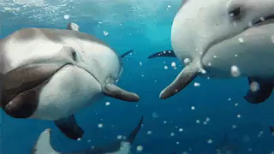
There are many fields of ecology.
Some ecologists study a specific species or habitat. They might study the behaviour of a single species to see how it interacts with other organisms and the environment.
Other types of ecologists might study many different species that either depend on each other, or compete with each other for food and space.
Lots of things are still to be discovered. That's what makes it so exciting!

Slide 7
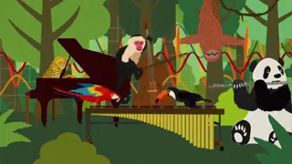
If you've ever wondered about the world around you, then this module is for you!
Throughout the module, you will learn how different animals interact with one another and with their environment.
You will also learn about the different mechanisms and traits that plants and animals use to survive in their environment!
Well, what are you waiting for? Let's get started!

Slide 8
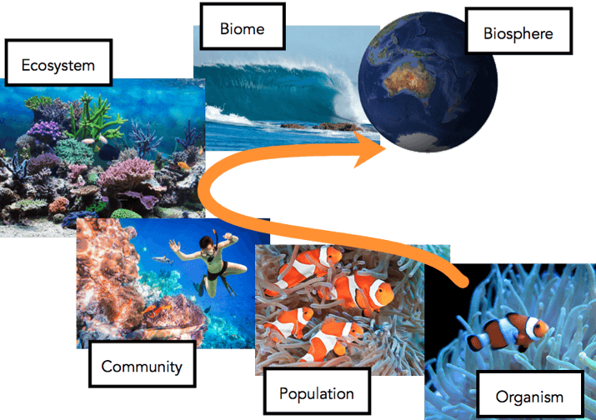
Grouping living things by level of complexity means that ecologists can study them in different ways.
The diagram below illustrates the different levels of organisation of living things.

Slide 9
The arrow moves from the most simple level (organism) of organisation to the most complex level (biosphere).
More factors are incorporated as the levels increase in complexity. For example, the more complex levels take into account other organisms, the environment, and interactions with other species.

Slide 10
Let's start with the most complex level: the biosphere.
The biosphere is all about life. It is the place where all life exists and is composed of biomes.

Slide 11

The biosphere is made up of all the microbes, plants and animals on Earth.
It extends from the surface of the Earth to the upper areas of the atmosphere. It also reaches into dark caves deep in the ground, or to the bottom of the ocean.
The biosphere extends to any place that life of any kind might exist.

Slide 12
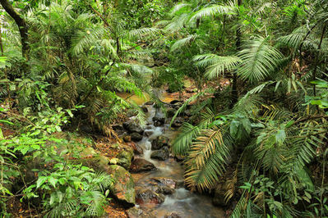
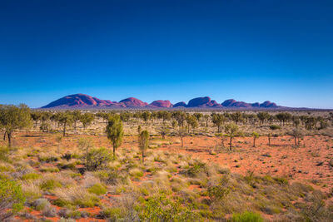
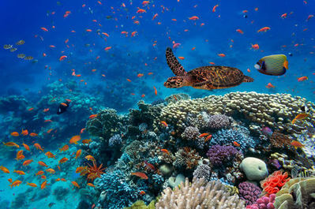
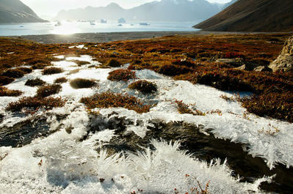
The next level down from the biosphere is biomes.
Biomes are regions of the world with similar climate, animals and plants.

Slide 13
There are five major types of biomes:
Aquatic
Desert
Forest
Grassland
Tundra
The major biomes can then be broken down into more specific regions.
For example, the aquatic biome can be divided into freshwater and marine regions.

Slide 14
